Slide 1


Retail Analytics: Price Optimization Model

Slide 2


Project Mentors
Mr. Sharath Manikonda
Director, Innodatatics
https://www.linkedin.com/in/sharat-chandra
C. Gomathi
Mentor
https://www.linkedin.com/in/gomathi-chakravarthy-20a103241/

Slide 3








Team Members:
Name: Srikanth Dasari
LinkedIn URL –
https://www.linkedin.com/in/srikanth-dasari-001a8b1ab
Name: Prajay Urkude
LinkedIn URL –
https://www.linkedin.com/in/prajay-urkude-393a46110/
Name: Darshana Mahindrakar
LinkedIn URL –
http://www.linkedin.com/in/darshana-mahindrakar-458773217
Name: Arish Naqvi
LinkedIn URL-
https://www.linkedin.com/in/arish-naqvi-7bb789141/
Name: Kapil Khot
LinkedIn URL –
https://www.linkedin.com/in/kapil-khot-bb7634238/
Name : Kewal Sarode
LinkedIn URL-
https://www.linkedin.com/in/kewal-sarode-8149ab23a/
Name: Dileep Kumar
LinkedIn URL-
http://www.linkedin.com/in/dileep-kumar-19919b201
Name: Manpreet Singh
LinkedIn URL –
https://www.linkedin.com/in/manpreet-singh-9a5747122

Slide 4







Team Members
Name: Muhammed Amer Hussain
LinkedIn URL –
https://www.linkedin.com/in/muhammed-amer-hussain-91179821a
Name: Uma Mahesh Chinta
LinkedIn URL –
https://www.linkedin.com/in/uma-mahesh-chinta-871a091bb
Name: Shaikh Mohammad Izhar
LinkedIn URL –
https://www.linkedin.com/in/shaikh-mohammad-izhar-793746238/
Name: Dasanagari Anil Kumar
LinkedIn URL –
https://www.linkedin.com/in/dasanagari-anil-kumar-8870551b3
Name: Kiran Inumula
LinkedIn URL –
https://www.linkedin.com/in/kiran-inumula-6545i
Name: Sagar Khiste
LinkedIn URL –
https://www.linkedin.com/in/sagar-khiste-609ba537
Name: Usha Rani Sahoo
LinkedIn URL –
https://www.linkedin.com/in/usha-rani-sahoo-1737b3228

Slide 5

Contents
Price Optimization Definition
Project Overview and Scope
Project Goals
CRISP-ML(Q) Methodology
Technical Stacks
System Requirements
Project Architecture
Data Collection
Data Understanding and Feature Selection
Data Pre-Processing
Exploratory Data Analysis
Model Building
Model Deployment
Deployment Output
Challenges
Future Scope

Slide 6
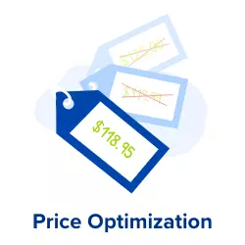
Price Optimization Definition
Price optimization is the process of identifying the optimal price point for any given product at any given location that will yield the highest profit
The right pricing can make or break a business and copying your competitors might mean starting a price war, but making a guess could leave you balking at abysmal sales numbers.
Hence, successful price optimization is a matter of a balance that can have a major impact on your sales, customer satisfaction, profits, and achievable growth goals.

Slide 7

Project Overview and Scope
This project focuses on predicting an optimal price for a product which will yield maximum profit by increasing the product sale.
This prediction system will help the client to get a suggested price based on the selling cost of a product and the number of products sold.
The project will have a connection between the server where the sales data will be stored and the model will fetch the data to predict the optimized price. The deployment will be using streamlit.
We are building this tool to minimize time and manpower & provide as accurate and thorough results as possible.

Slide 8


Project Goals
Objectives
Constraints
To identify the best price by understanding pricing policy of each product in the retail market based on price optimization.
To maximize the profitability and sales by finding the optimal price of a product.
To minimize churning rate of customers to other vendors.
Changing in market demand of retail products may affect the optimized price.
Price optimization for a product family –
Any changes in the pricing of one product, may trigger a chain reaction across a product family. Hence, the pricing of product family becomes a daunting task.

Slide 9
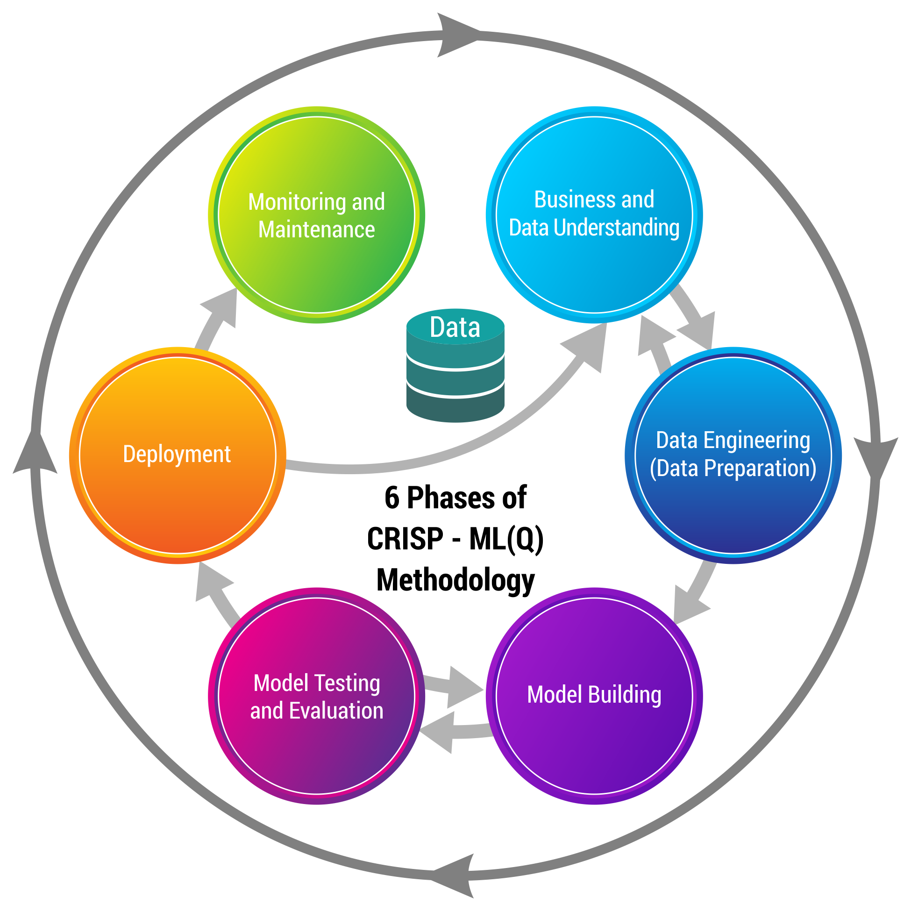
CRISP-ML(Q) Methodology

Slide 10



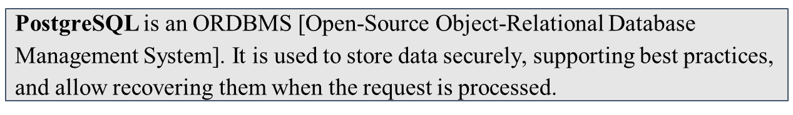

Technical Stacks
Python is a general-purpose programming language. We used it for Data Cleaning, EDA, Model Building and Visualization.
Language
Spyder is an integrated development environment (IDE) for scientific programming in the Python language.
IDE
Jupyter Notebook is a web-based interactive computing platform. It is an open-source IDE that is used to create Jupyter documents that can be created and shared with live codes.

Slide 11




Technical Stacks
Libraries
Numpy can be used to perform a wide variety of mathematical operations on arrays.
Pandas is a fast, powerful, flexible and easy to use open source data analysis and manipulation tool, built on top of the Python programming language.
Matplotlib is a comprehensive library for creating static, animated, and interactive visualizations in Python.
Deployment
Streamlit is an open-source python library for creating and sharing web apps for data science & machine learning projects.

Slide 12

System Requirements
System Requirements
Memory: 8GB RAM
CPU: Intel Core i3 and above
OS: Windows 10 & above
Prepare Environment
Install python version 3.8
Install Anaconda software to launch IDE platform like Spyder and Jupyter
Creating a new Environment
Install Pandas for preprocessing of data
Install Numpy for mathematical calculations
Install Matplotlib for Visualisation
Install Streamlit for Deployment

Slide 13
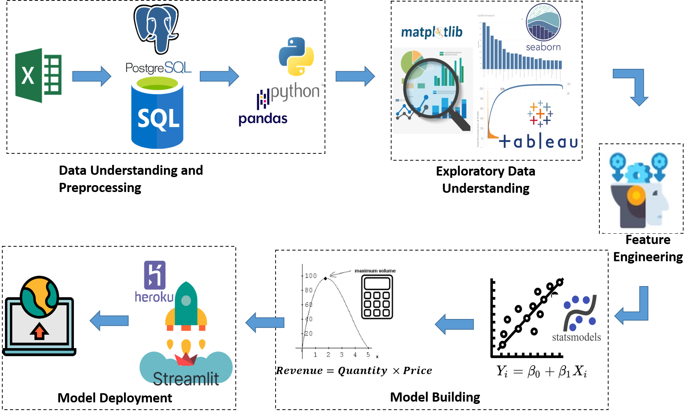
Project Architecture

Slide 14

Data Collection
Data Collection is defined as the procedure of collecting, measuring and analyzing accurate insights for research using standard validation techniques.
The transactional data is recorded from the client on a server. This server is duplicated for study purpose.
Using PostgreSQL, a virtual local server is created in which a database is created. This database has all the records of transaction.
The data consists of 37438 records having 4 zones, 128 material categories and 2312 different products.

Slide 15

Data Understanding
Particulars | Description
UID | Unique ID for a Material
NAME | Name of the Material
ZONE | Name of the zone of Business
Brand | Brand of the material
MC | Material Category: Category of the material
Fdate | Month of Sale
NSU | Net Sale Unit: Total units sold in a month
NSV | Net Sale Value: Total sale value in a month
GST Value | GST Value: GST on the NSV
(NSV-GST) | Calculation only
Sales at Cost | Cost to company

Slide 16
Data Understanding
Particulars | Description
SALES AT COST | Calculation only [(NSV-GST) – Sales at Cost]
MARGIN% | Percentage of Margin
Gross Sales | Gross Sales means the grand total of all sales transactions over a given time period.
Gross RGM(P-L) | Gross Margin
Gross Margin % (Q/P*100) | Gross Margin Percentage
MRP | Maximum Retail Price of unit item
SP | Selling price of unit item
DIS | Discount in Rupees.
DIS% | Discount in Percentage

Slide 17
Feature Selection
Data contains various features and the shape of the data is 20 columns and 37437 rows.
In this model the data is analyzed considering the below features for the model building.
Data Dictionary
Name of the features | Description | Data Type
NAME | Name of the Material | Nominal
ZONE | Name of the zone of Business | Nominal
NSU | Net Sale Unit: Total units sold in a month | Ratio
SP | Selling price of unit item | Ratio
Sales at cost | Cost to company | Ratio

Slide 18
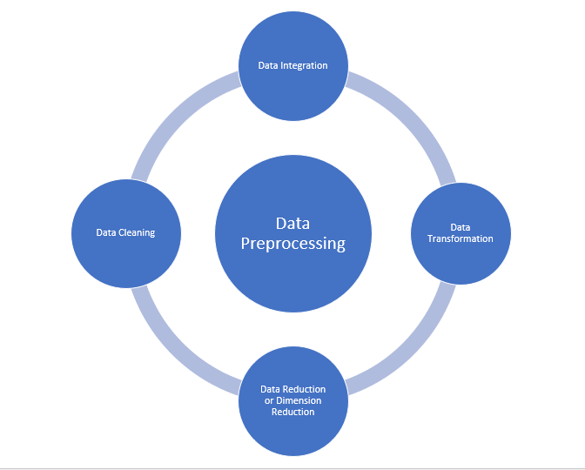
Data Pre-Processing
Steps in Data Pre-processing:
Data Cleaning
Fill in missing values, smooth noisy data, identify or remove outliers and resolve inconsistencies
Data Integration
Integration of multiple databases, data cubes, files, or notes
Data Transformation
Normalization (scaling to a specific range)
Data Reduction
Obtains reduced representation in volume but produces the same or similar analytical results

Slide 19

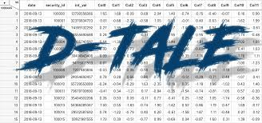

EDA Description
Analyzing the Dataset:
By using these automated EDA’s like “SweetViz” and “D-Tale”, we analyzed datasets to summarize their statistics for numerical data and creating various graphical representations to understand the data better.
Measures of central tendency -
Mean
Median
Mode
Measures of dispersion -
Standard Deviation
Variation
Third and Fourth Business Moment Decisions -
Skewness
Kurtosis

Slide 20
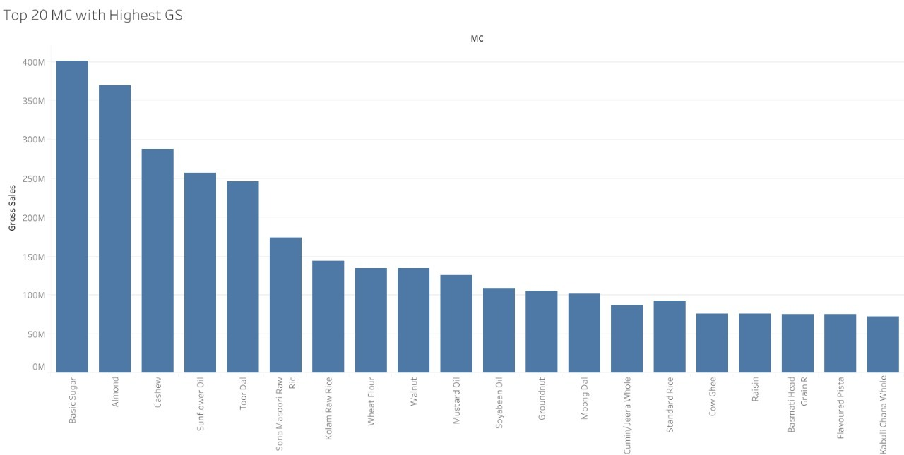
Exploratory Data Analysis
Top 20 Material categories By Gross Sales:
Material category Brown sugar has the highest gross sale.
Almond has second highest gross sale.

Slide 21
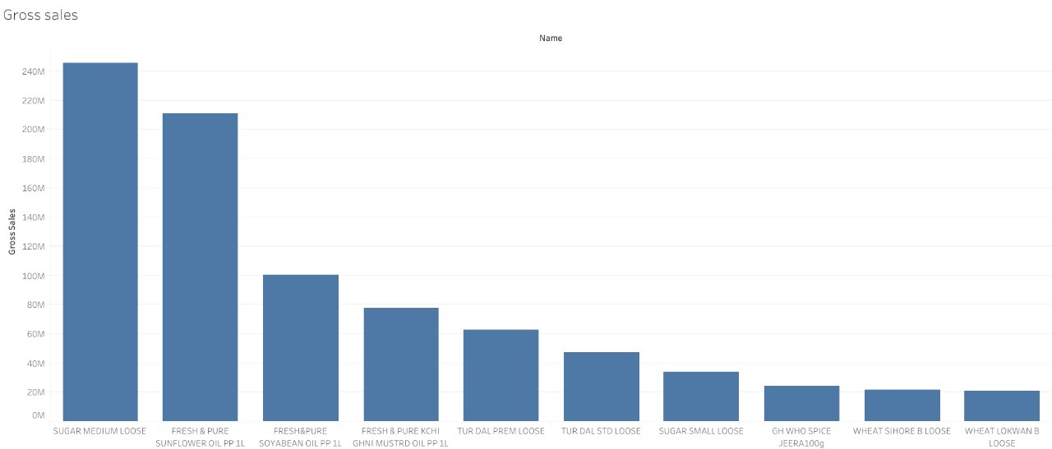
Exploratory Data Analysis
Top 10 Items By Gross Sales:
Item sugar medium loose has the highest gross sales among all the items.

Slide 22
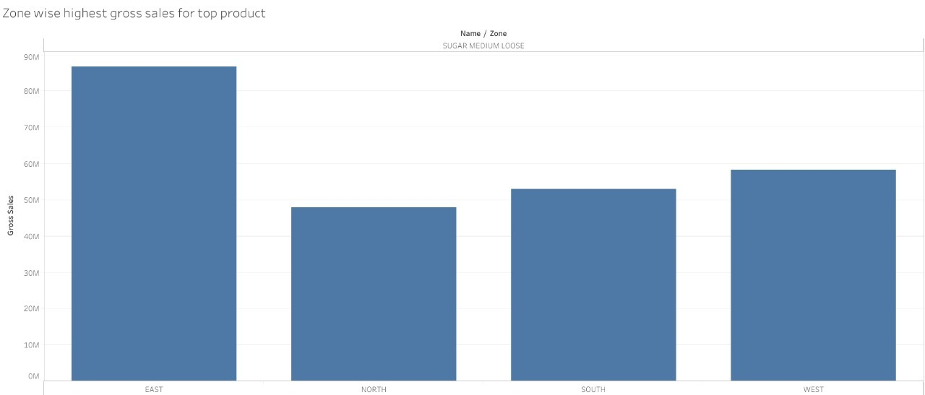
Exploratory Data Analysis
Zone wise highest gross sales for top products:
East Zone has highest gross sales
North Zone has lowest gross sales .
Job Dataset

Slide 23
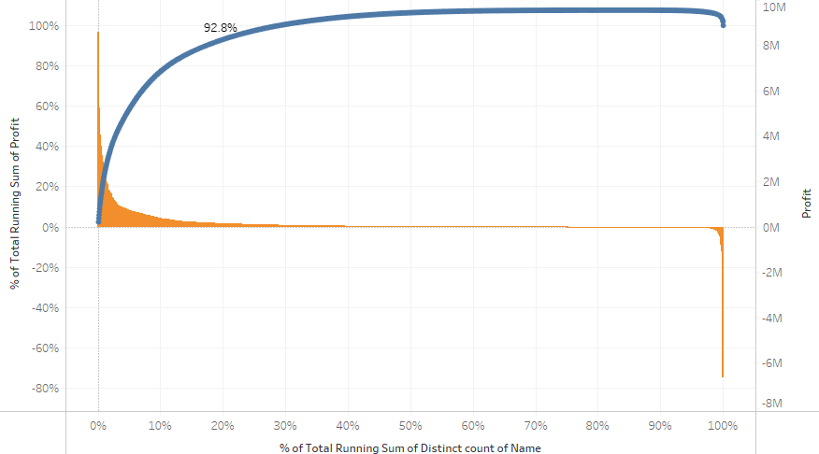
Exploratory Data Analysis:
Pareto Chart:
This chart 80% of the profit comes from 20% of profit of items. From that we have to keep eye on item under this 20% region.

Slide 24
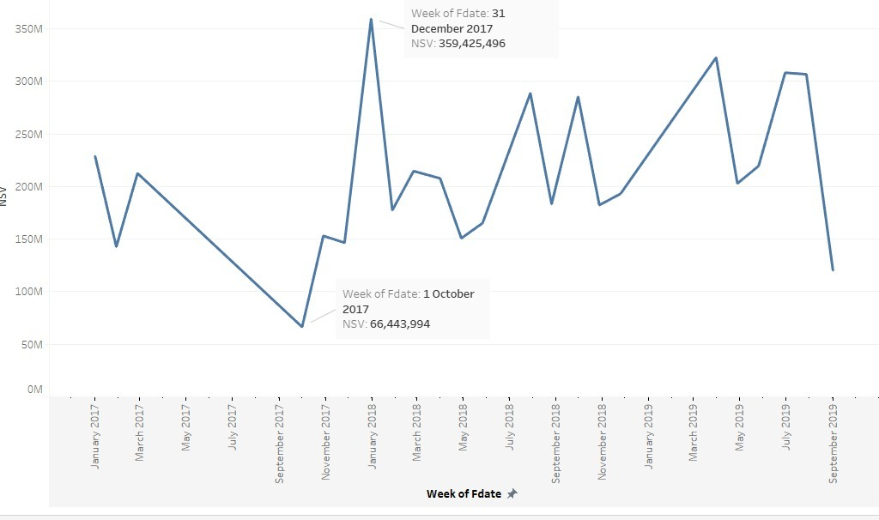
Exploratory Data Analysis
Sales Over time:
Consistently sales is getting high in the month of december/ january .
Consistently sales is getting low in the month of september.

Slide 25
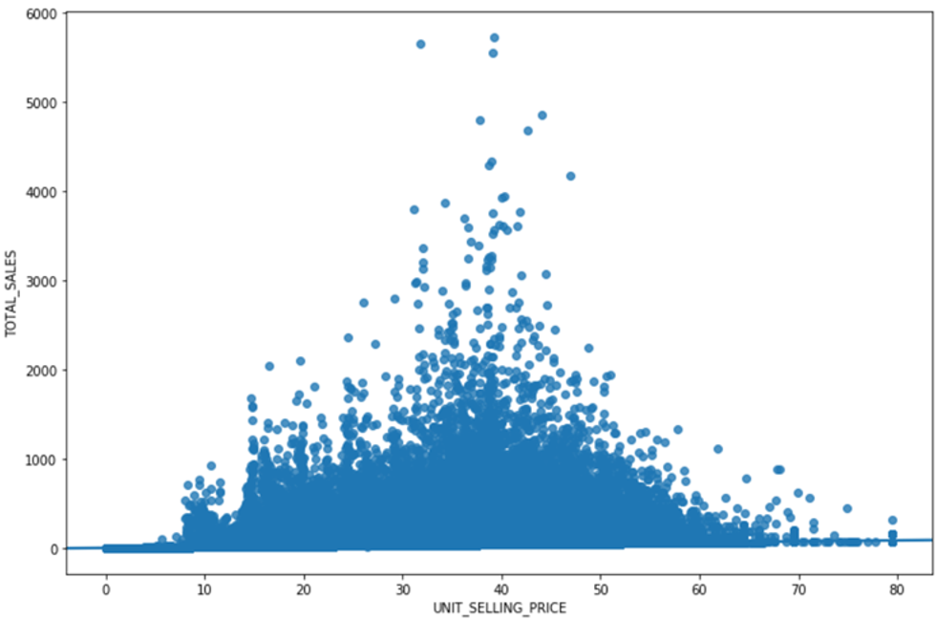
Exploratory Data Analysis
At Low selling price, sales is less
After Certain point, higher selling price does not result in higher profit

Slide 26
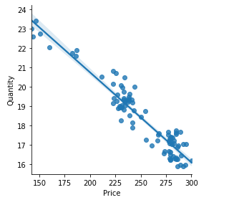
Model Building
Optimize selling price of the product to maximize profit and sales.
Price elasticity ideally needs data on how customers react to price variation.
A demand curve helps analyze the maximum price at which demand is not impacted.
We will use existing data to draw demand curve to find range of potential sales price to optimize revenue or profit
Based on the range, existing sales data will be used to predict or estimate the Selling price.
.

Slide 27
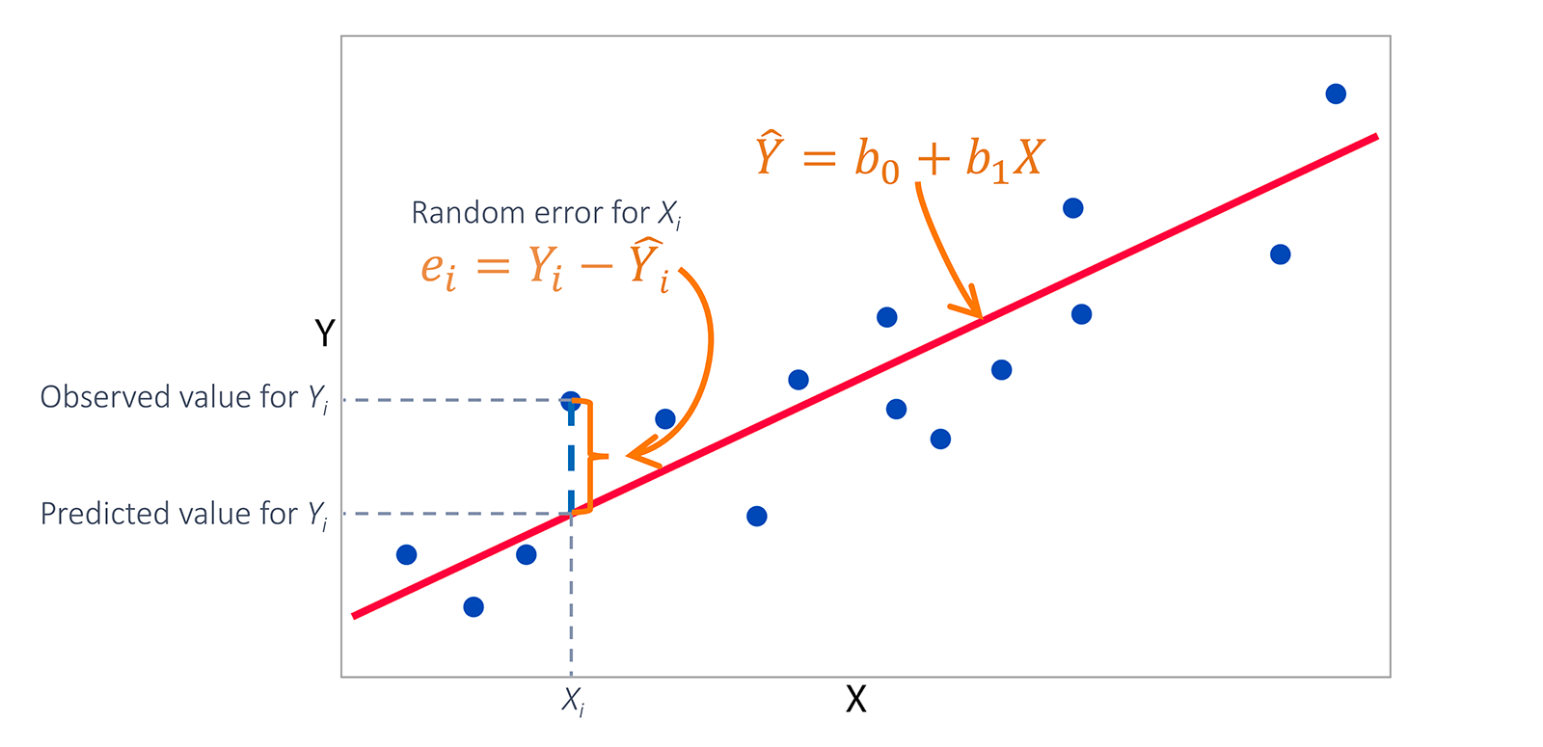
Model Building
Ordinary Least Squares regression (OLS) :
OLS is a common technique for estimating coefficients of linear regression equations which describe the relationship between one or more independent quantitative variables and a dependent variable (simple or multiple linear regression).
The simple linear regression is a model with a single regressor (independent variable) x that has a relationship with a response (dependent or target) y that is a
y = β0 + β1 x + ε
Where
β0: intercept
β1: slope (unknown constant)
ε: random error component
This is a line where y is the dependent variable we want to predict, x is the independent variable, and β0 and β1 are the coefficients that we need to estimate.

Slide 28
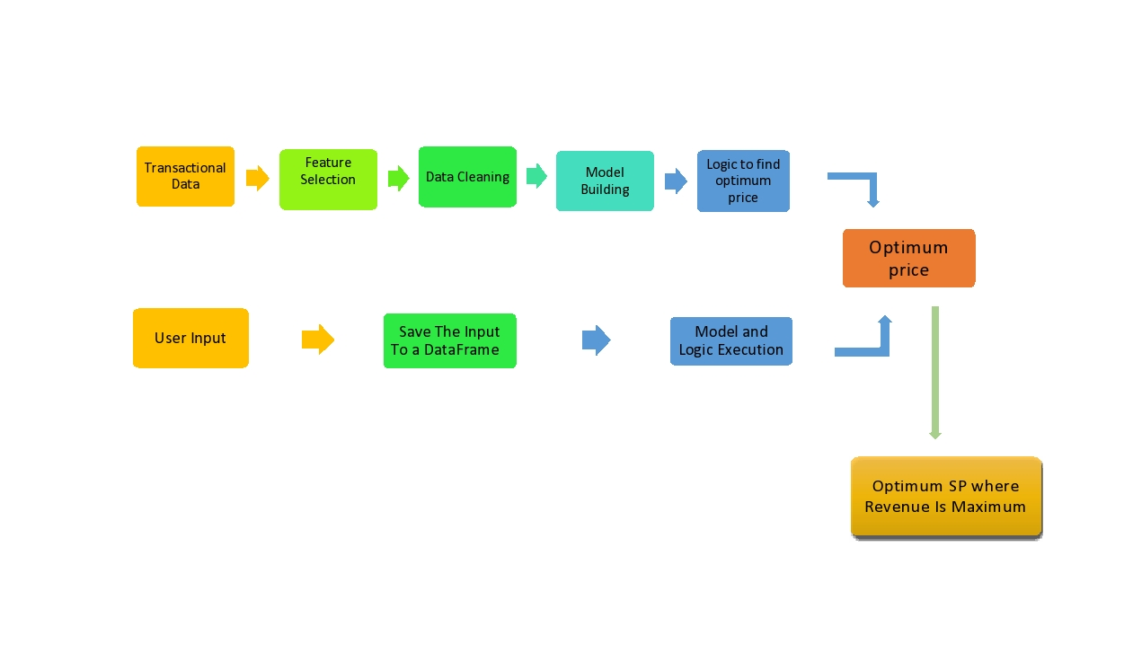
Model Building
Content - Price optimization for maximizing revenue by using Linear regression:
Regression analysis employing the use of historical data is widely used to estimate the effect of changes in price on sales.
Historical data can provide insight as to how sales volume will be affected by changes in price and market variables such as; seasonality, advertising, promotions, competitive product prices and other variables deemed appropriate.
Regression analysis produces a price elasticity measurement that quantify es the price sensitivity of consumers with respect to the observed product.
Fig : Model Building Process

Slide 29
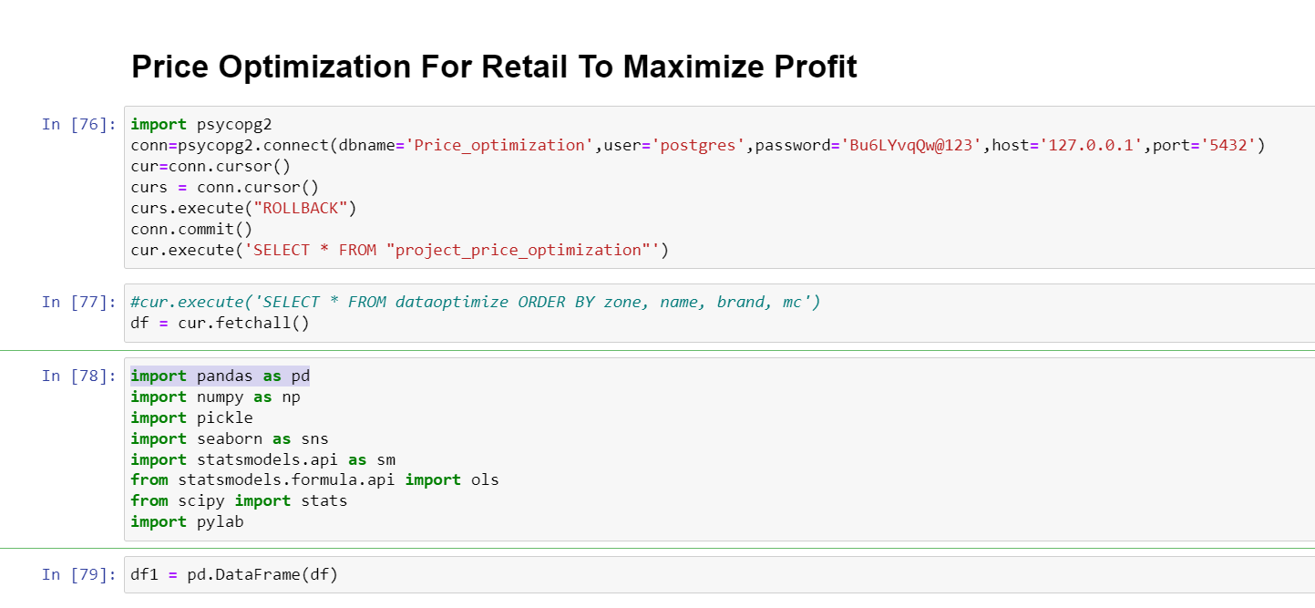
Model Building

Slide 30
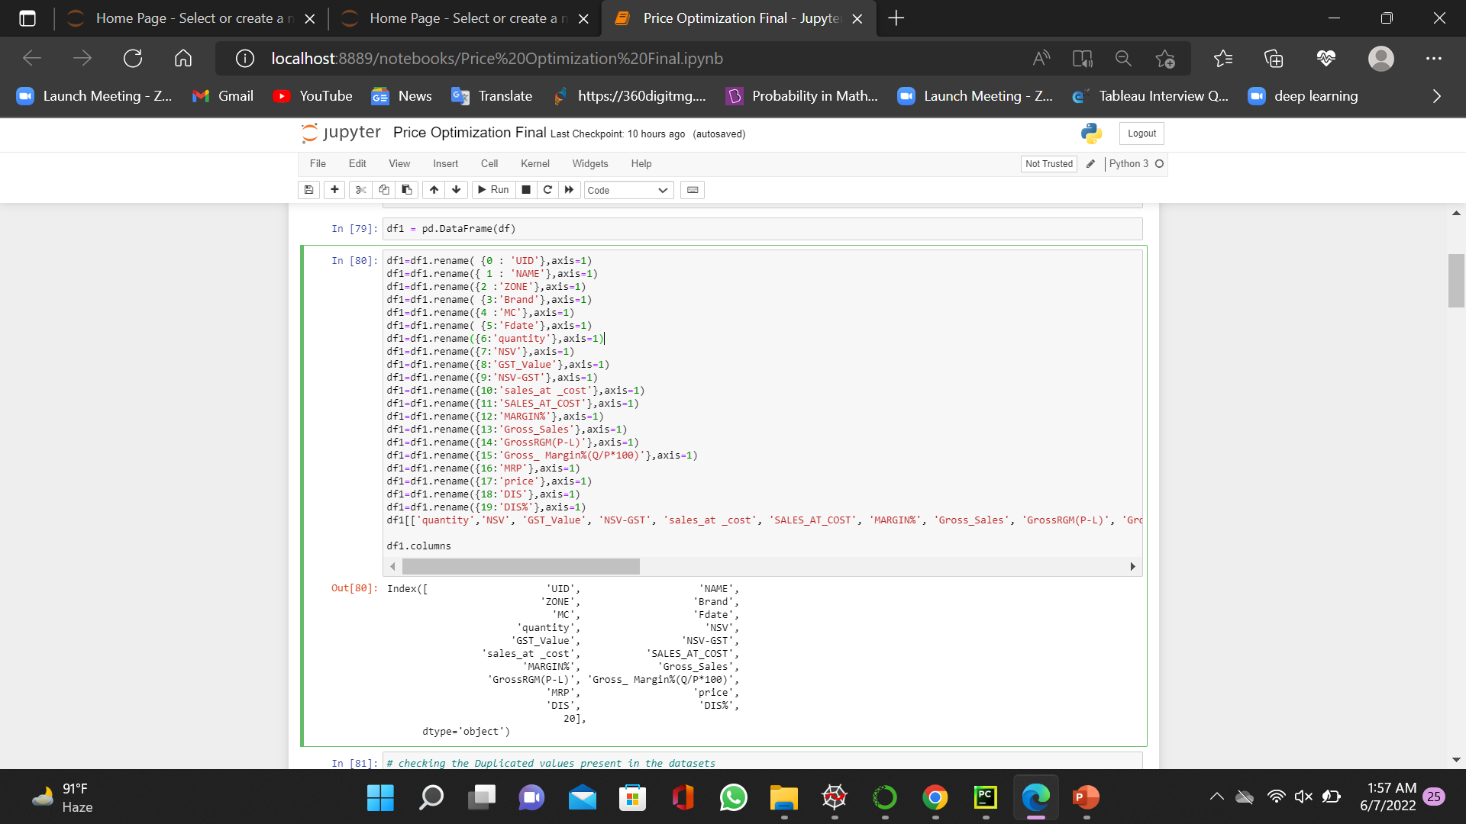
Model Building

Slide 31
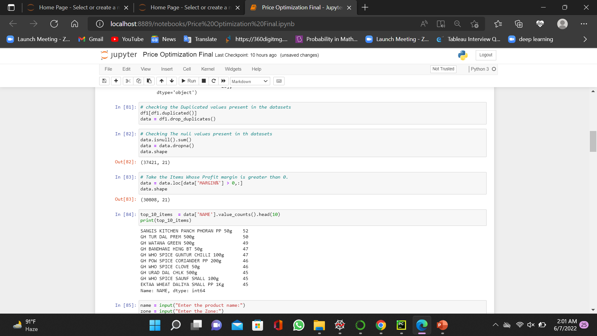
Model Building

Slide 32
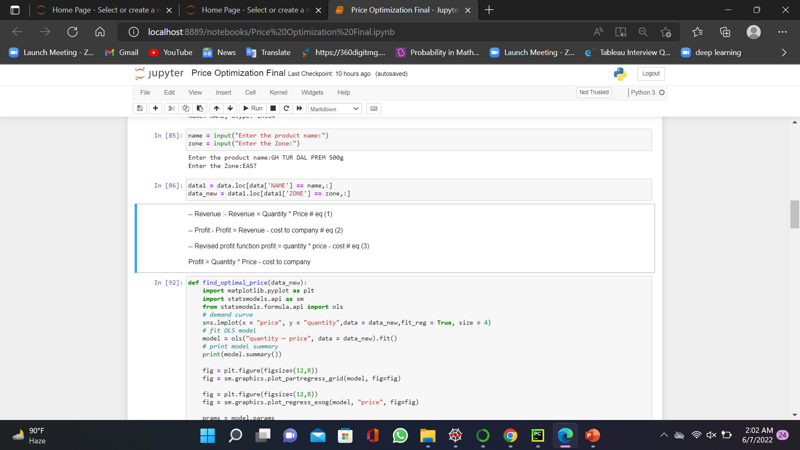
Model Building

Slide 33
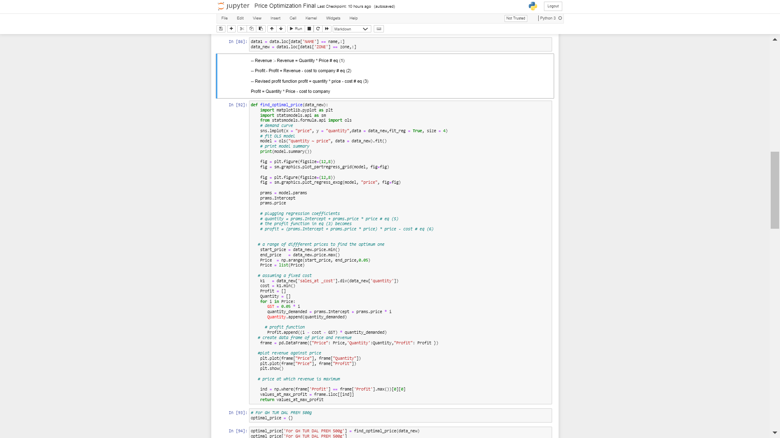
Model Building

Slide 34
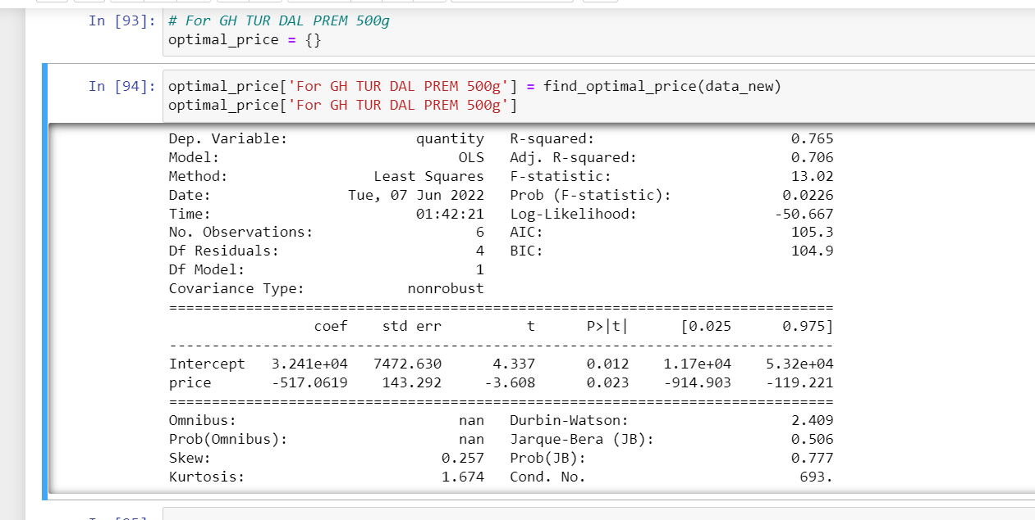
Model Building
Model Summary for Popular product GH TUR DAL PREM 500g :
R – square value is 0.765
P – Values are less than 0.05 for both the features.

Slide 35
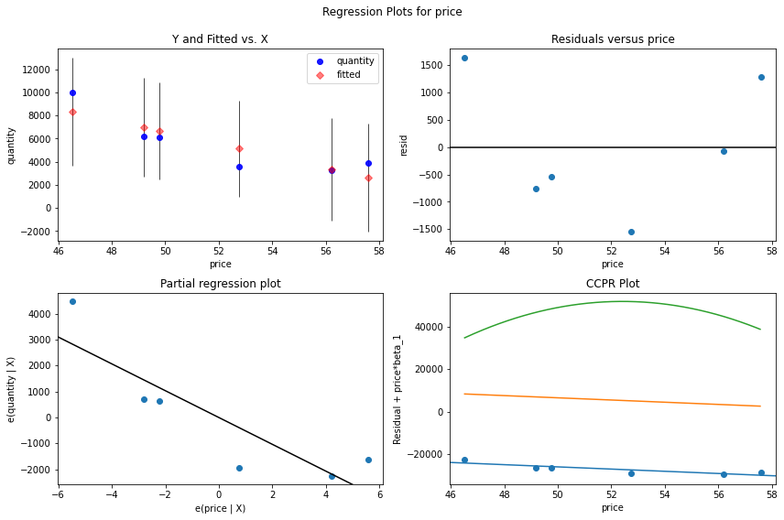
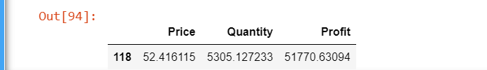
Model Building
Partial Regression Plot for Popular product GH TUR DAL PREM 500g ::

Slide 36
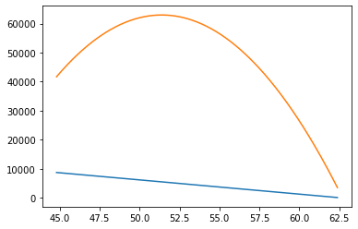
Model Building
Demand curve for popular product GH TUR DAL PREM 500g :
Demand peak is when selling price is between 49 to 55. above 55 people are resisting to buy it
If price and revenue are plotted, we can visually identify the peak of the revenue and find the price that makes the revenue at the highest point on the curve.
So we find that the maximum revenue at different price levels is reached at 550000 when the price is set at 89.

Slide 37

Model Deployment
Web based deployment was used to deploy code from source control to hosting platform
Streamlit library was used for app deployment
Streamlit integrates with GitHub to make it easy to deploy code living on GitHub to apps running on streamlit
Pickle the required files (unique products,zone )
Create a GitHub repository containing all the required files (pickled files, installation requirements, text files) etc.
Create an app in streamlit and connect it to the GitHub repository

Slide 38
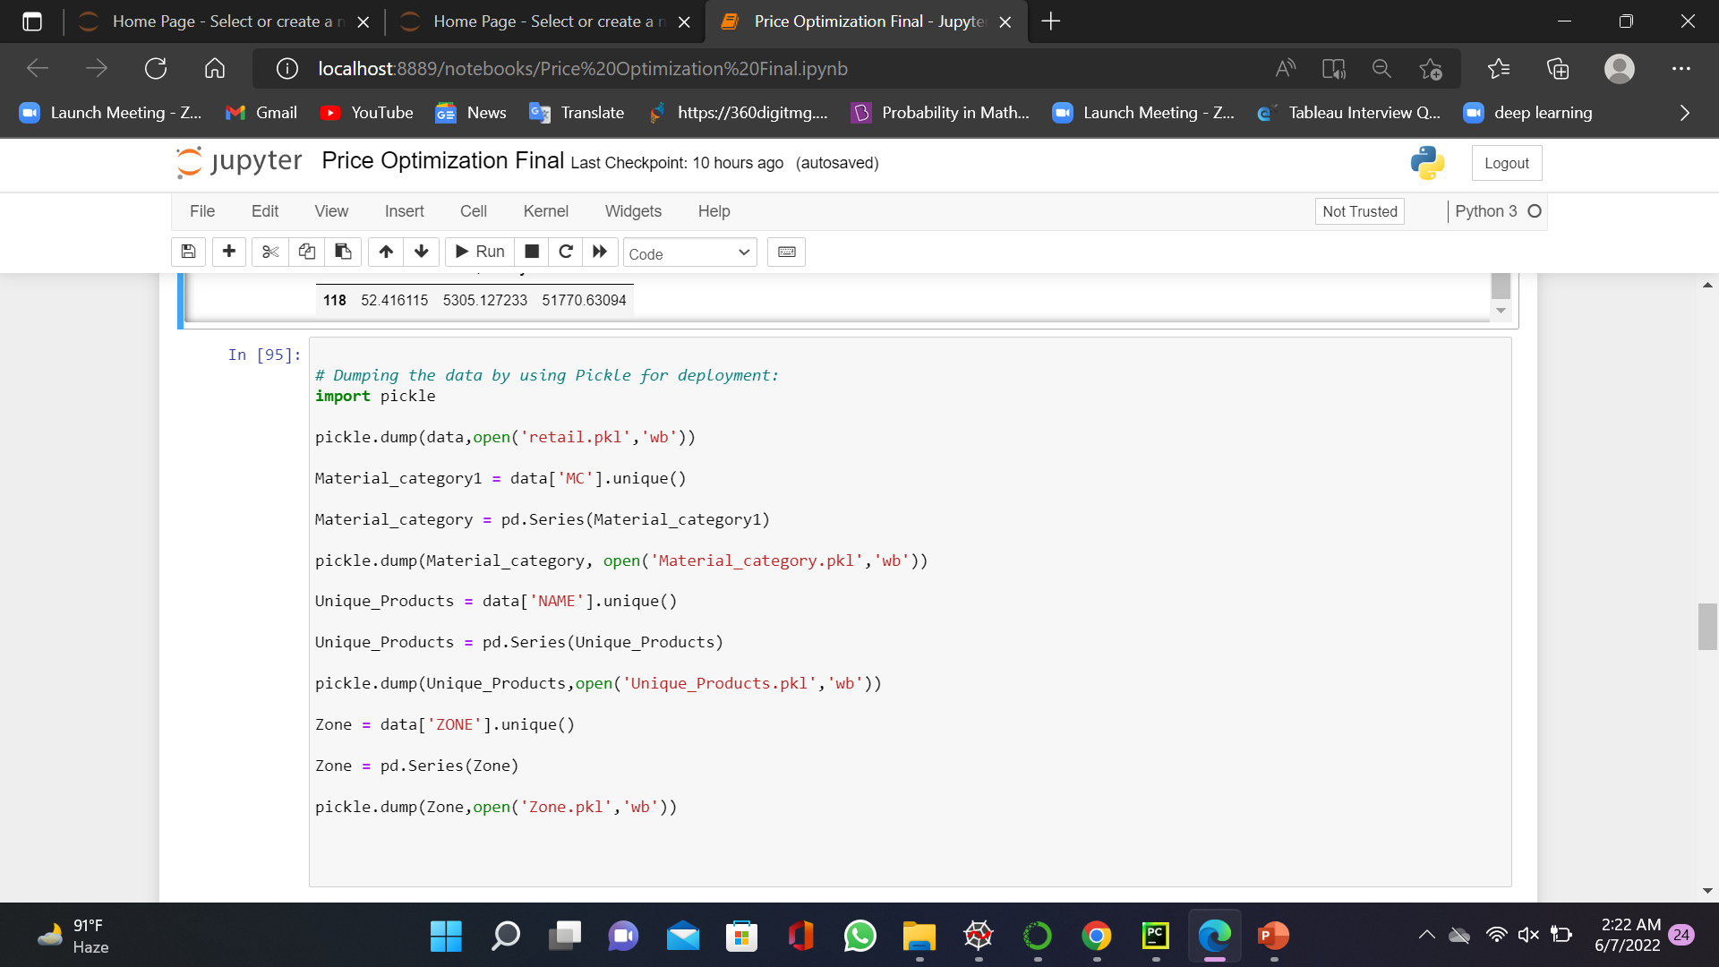
Model Deployment
Creation of Pickle Files:

Slide 39
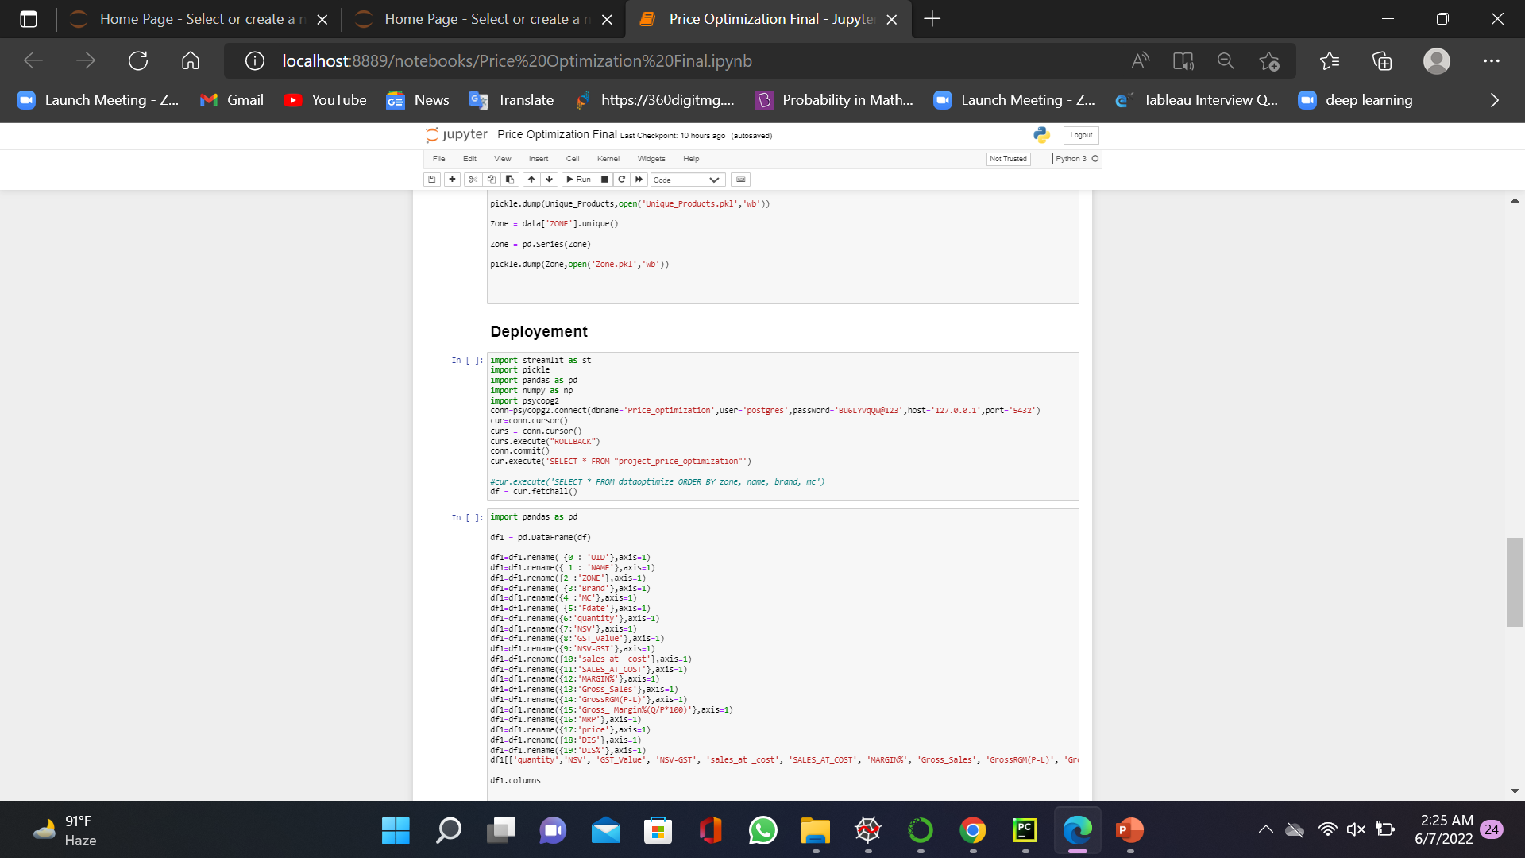
Model Deployment

Slide 40
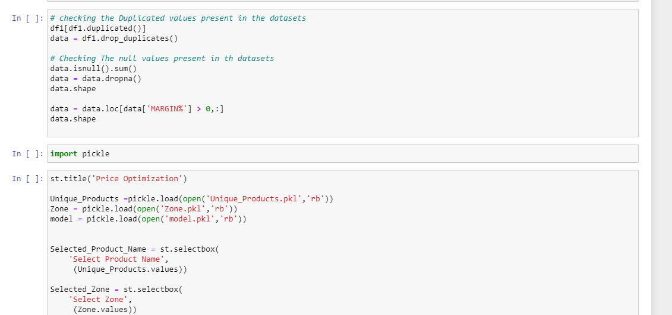
Model Deployment

Slide 41
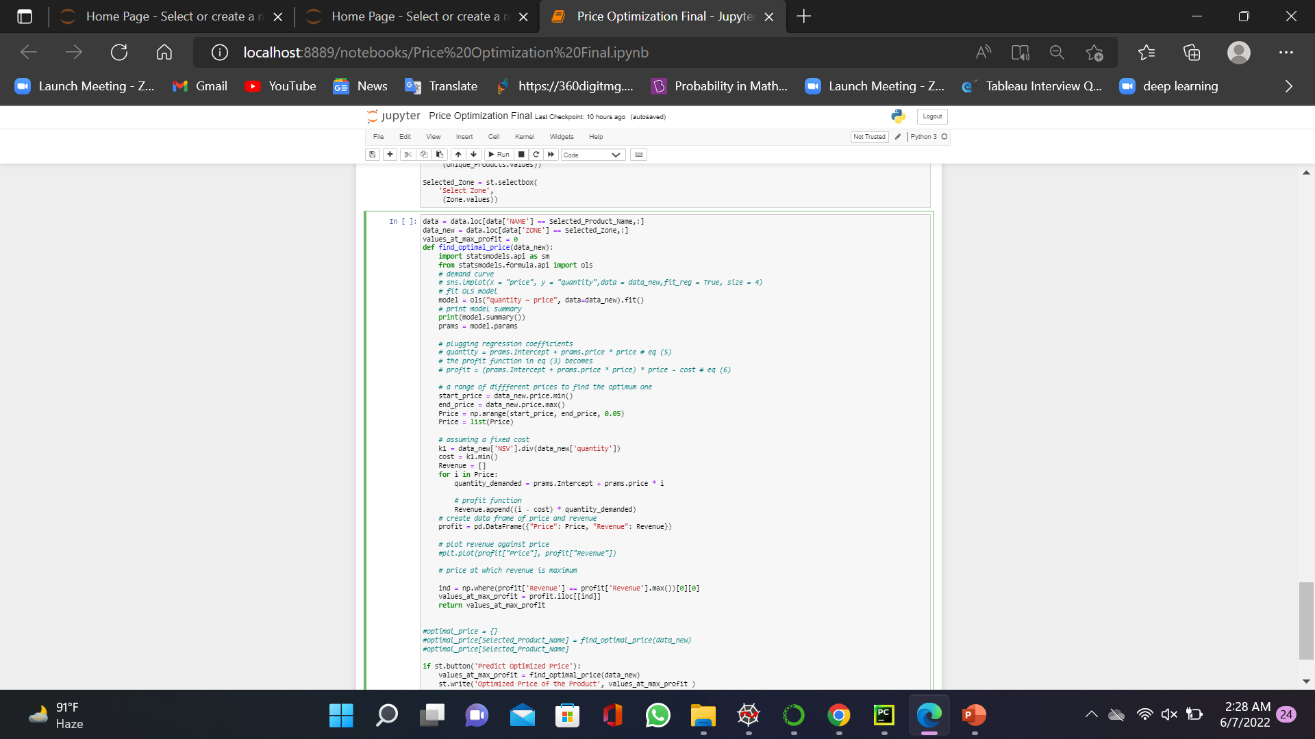
Model Deployment

Slide 42
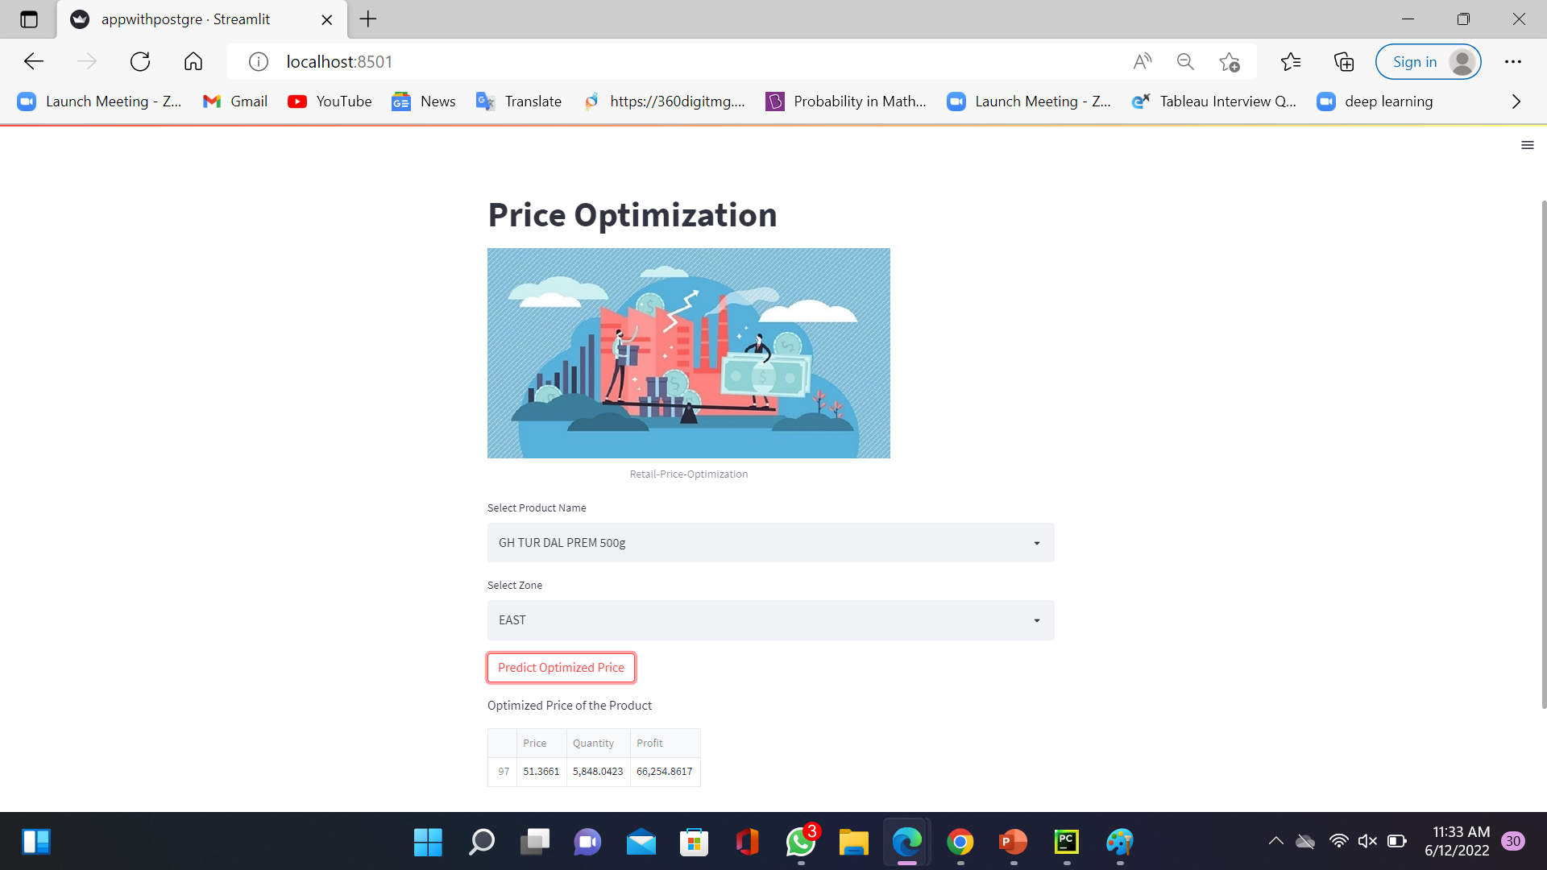
Model Deployment Output
42

Slide 43

Model Deployment Output

Slide 44

Challenges
Less data for different products
Dealing with missing values and outlier treatment
Research on various price optimization techniques

Slide 45

Future Scope
Customer Behavior Analytics :
Obtain customer data and categorise customers into regular, semi-regular and infrequent. Use analytics and machine learning models to understanding purchase behaviors of this users and adjust price and discounts accordingly.
Dynamic Pricing :
Pricing can further be optimized by regularly adjusting the selling price
(even on daily basis) by inputting the variables.
45

Slide 46

Queries ?

Slide 47

Thank you!

